Slide 1


Open and Responsible (Data) Science Citizenship 1
Louise Bezuidenhout
Leiden University
November 2024 CODATA-RDA Data Science School

Slide 2
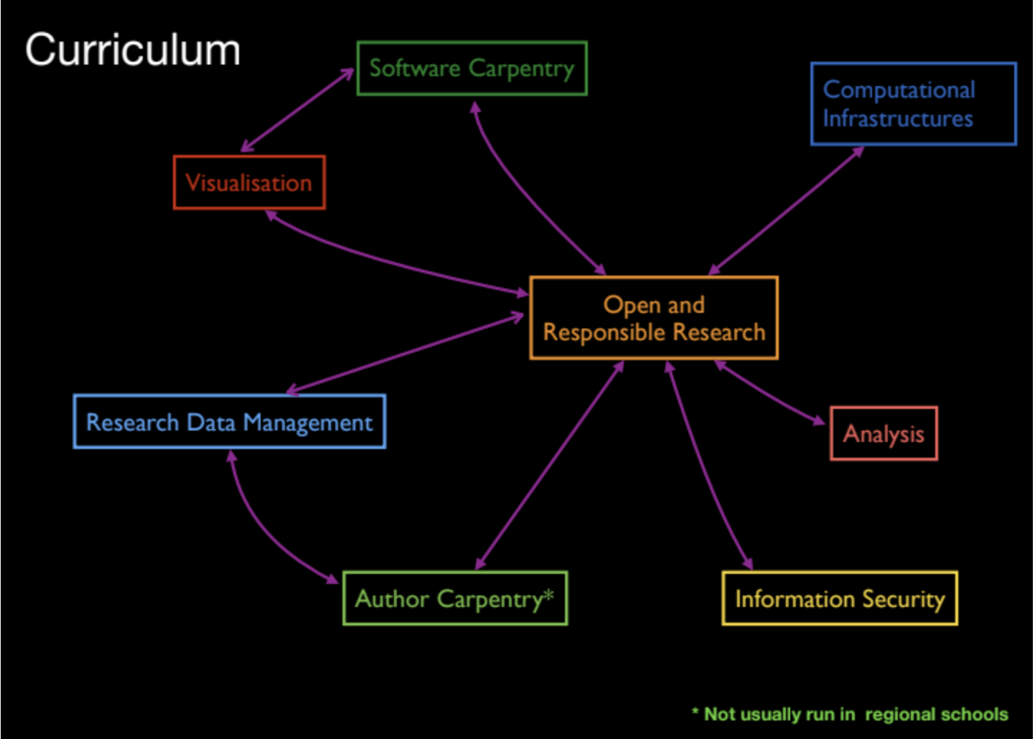
Our Curriculum
Responsible and Open Science citizenship

Slide 3
Plan for the Morning
Responsible conduct of research
Open Science as a new way of being responsible
Being a responsible, open science citizen
Not just about learning data science … learning responsible data practices
Please log in to partici.fi/28561866

Slide 4
Particify slide
partici.fi/28561866
Notes:
https://ars.particify.de/edit/28561866/series/Monday

Slide 5
Responsible Conduct of Research
Not just about being
“good at your work”
producing data
getting on with your colleagues
As knowledge producers, educators and recipients of public funds we have additional responsibilities as researchers

Slide 6
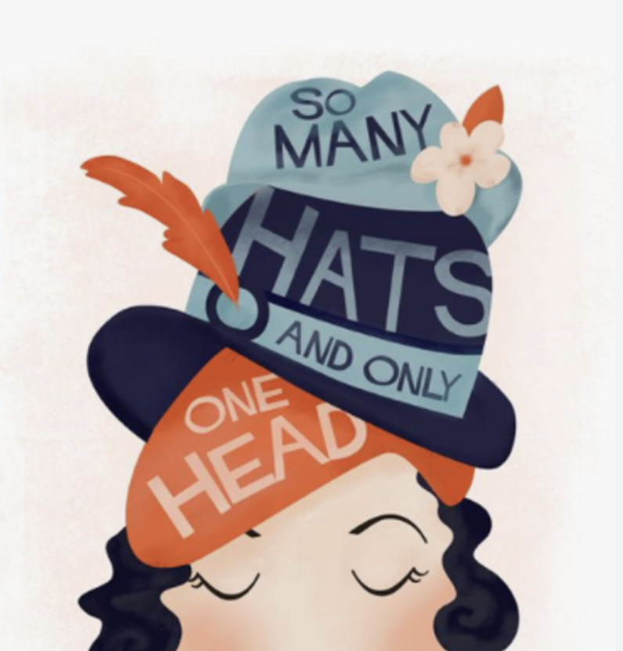
Balancing Multiple Roles as a Researcher
Data producer
Data user and/or collaborator
Author
Employee
Teacher/mentor
Recipient of public funds
Recipient of public trust
Citizen/legally-obligated individual
How do all these roles fit together?
Notes:
What we can see from the answers is that scientists wear many hats – these all come with different responsibilities

Slide 7
Responsible Conduct of Research
”FFPs: academic misconduct”
Teaching/pedagogy ethics
Bioethics
RDM
Publication ethics
Business ethics
https://www.nap.edu/catalog/12192/on-being-a-scientist-a-guide-to-responsible-conduct-in
Notes:
Most of these responsibilities are commonly synthesised into what is called a responsible conduct of research framework
Outlines the different areas of scientific research that raise ethical concerns
RCR frameworks highlight that being a responsible researcher is not just about being good at your work, it is about working in a specific manner that is ethical and has integrity
Talk about different areas
Expectations placed on scientists, codes of conduct etc

Slide 8
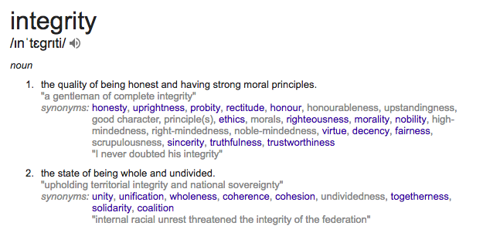
Responsibility as a Product of Integrity
Practice of scientific investigation with integrity
Notes:
Using a framework like RCR helps us to understand how highly different practices, like treatment of human subjects, criteria for authorship of articles and the disposal of laboratory waste all form part of the same, bigger picture
All of these different RCR activities enable individual scientists to practice scientific investivation with integrity

Slide 9
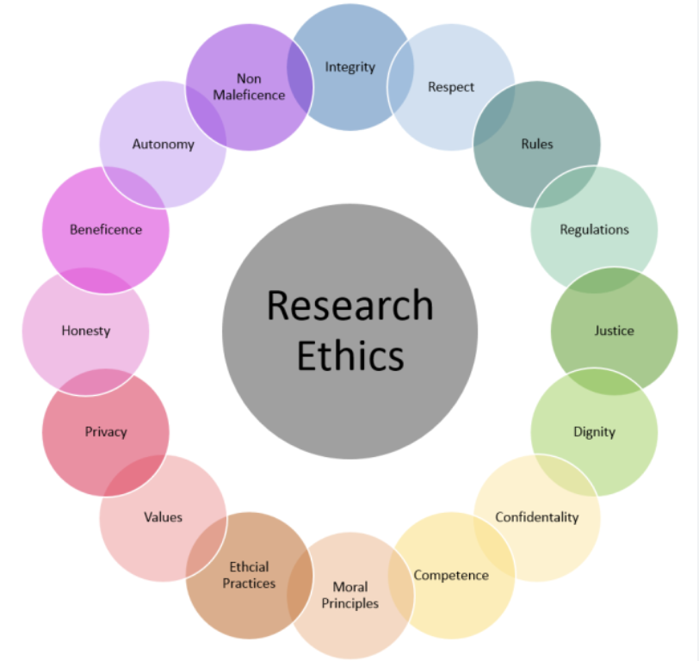
Key Ethical Norms
Responsible research involves the awareness and application of professional norms and ethical principles in all areas relating to research
Norms/value are the “glue” linking all research practices
Beneficence (do good)
Non-maleficence (cause no harm)
Equity and fairness
Diversity and inclusiveness
Quality and transparency
https://www.publichealthnotes.com/research-ethics-definition-principles-and-advantages/

Slide 10
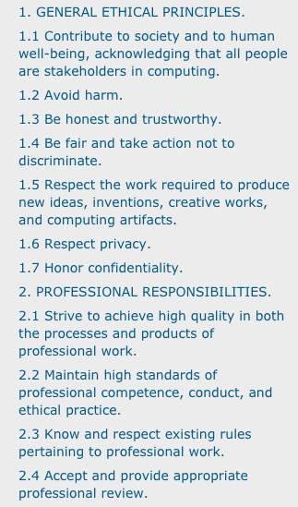
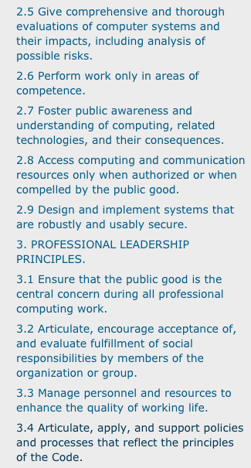
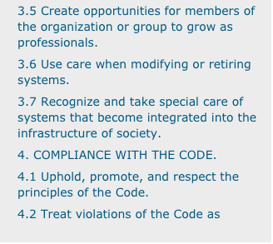
Codes of Conduct
Ethics are often outlined in disciplinary codes of conduct
Can be helpful ways of summarizing areas of activity to think about in relation to RCR
https://www.acm.org/code-of-ethics

Slide 11
RCR as a Collaborative Endeavour
Moving beyond the idea of “evil scientist” and “ivory tower”
Focus on research ecosystems
Researchers
Research support staff
Institutions
National/international context
Society
Notes:
It is important to recognize that effective RCR is a collaboration between individual scientists and their environment
Indeed, no one expects you to do it alone
While once in a while you may have a bad apple, it is usually the case that cases of misconduct occur when the environment is not supportive of responsible conduct
Thus, the environment needs to support the scientist for responsible conduct by providing training, resources, guidance and infrastructures

Slide 12
Institutional Responsibilities
Education
Infrastructures that support responsible research
Capacity for dealing with concerns/whistleblowing/misconduct
Engagement and compliance with inter/national regulation
The roll-out of RCR can be patchy. We will discuss this more in the next ethics lecture.

Slide 13
Responsible Research as a Collaboration
RCR is not left up to the individual
Expectations of conduct
Research integrity training
Ethical review of research proposals
Legal oversight to ensure compliance with national and international laws
Data management and curation
Ideally all aligned to support common ethical norms and values

Slide 14
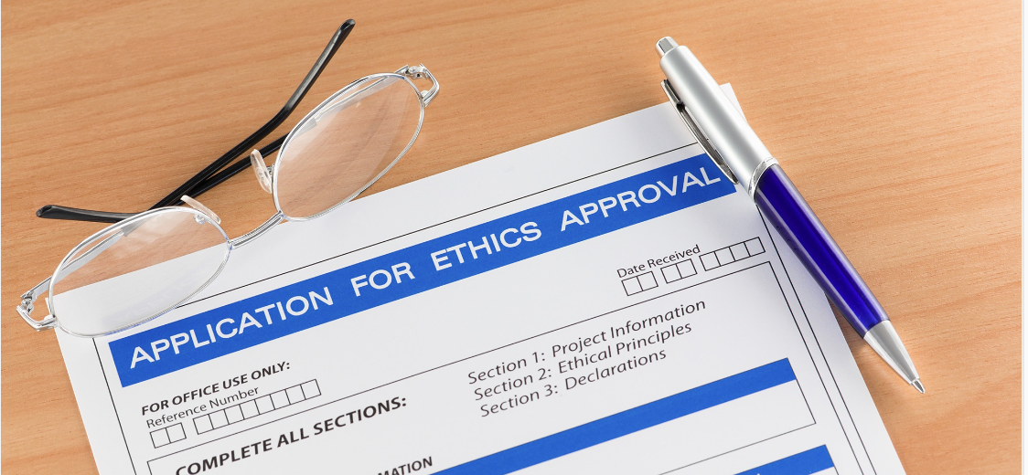
RCR as an Extended Form of Research Ethics
Right to withdraw
Confidentiality
Informed consent
Autonomy
Freedom from harm or disadvantage
Human centred research ethics
Fostering ethical excellence instead of avoidance of misconduct

Slide 15
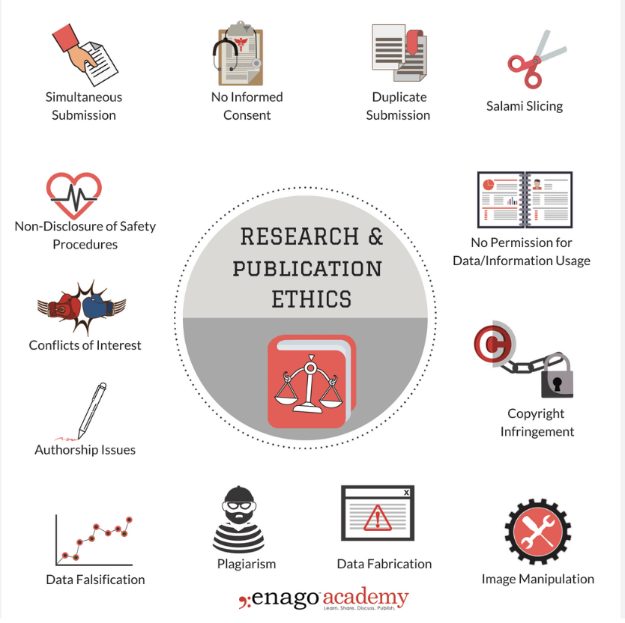
Extending the Reach of Ethics in Research
Produce verifiable and re-usable data
Protect scientists and societies from harm
Enable collaboration
Ensure investments (financial, trust, time etc) are recompensed
Embeds science within cultural/social priorities
https://www.enago.com/academy/principles-of-ethical-research/

Slide 16
Moving Beyond the Individual
RCR focused on research integrity and research systems that support research integrity
Responsibility of individuals and individual institutions to produce beneficial research in service of society
How does this work as research and data becomes more digital?

Slide 17
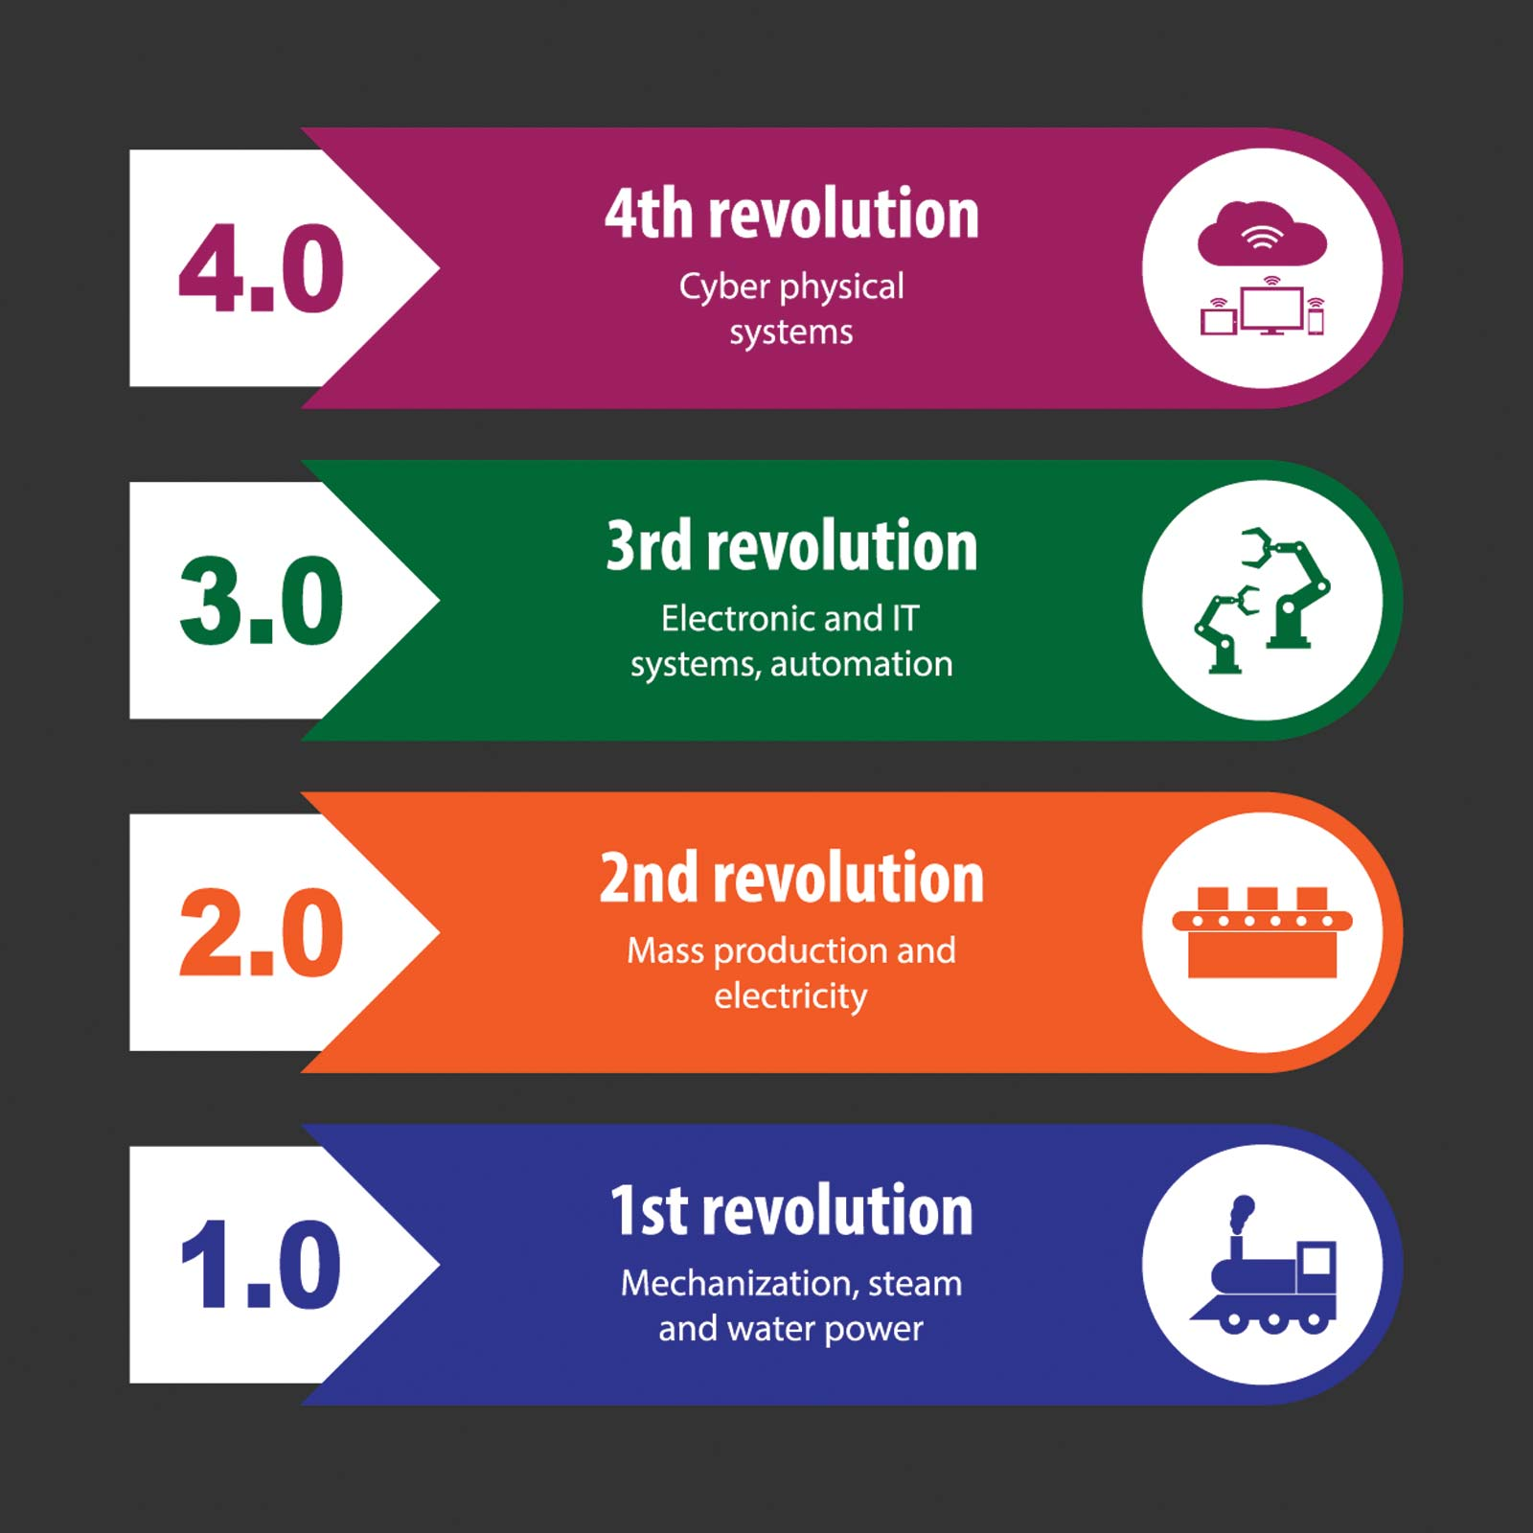
The Digital Revolution
Data “deluge”
Big Data
AI
Increasing opportunities and prioritization of interdisciplinary research
https://www.britannica.com/topic/The-Fourth-Industrial-Revolution-2119734

Slide 18
Changing Research Environments
Advances in computing have not only changed research, but come at a time of significant change in research
A number of issues are changing the way we think/talk/govern research
Reproducibility crisis
Siloing of research resources
Increased scrutiny of public investment in research
Sustainable Development Goals (SDGs)
Blurred boundaries between academia, commerce and government
Increased pressure for public access to research resources
Citizen science movement
Driving forward new models of research practice

Slide 19
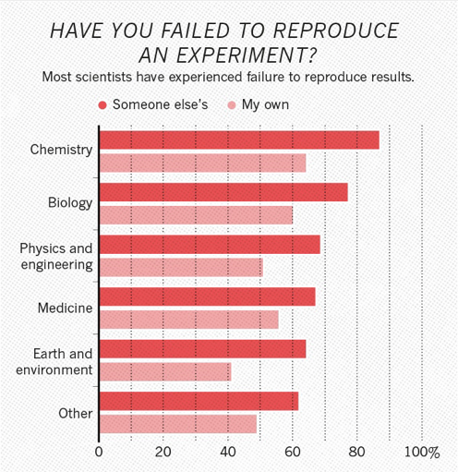
1. The Reproducibility Crisis in Research
Nature survey of 1,576 researchers (Baker et al 2016)
https://psyarxiv.com/qkwst/

Slide 20
A General Consensus on the Crisis
Variability in analysis and methodology
Incentives aligned towards publication not reproducibility
Lack of transparency and access to data
Nature survey of 1,576 researchers
(Baker et al 2016)
Notes:
Increasing transparency and quality
in the research validation
process, by allowing greater replication and validation of
scientific results.
•

Slide 21
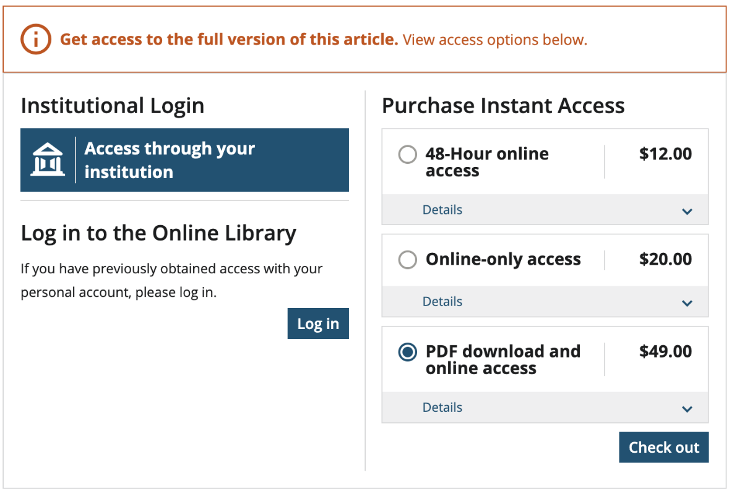
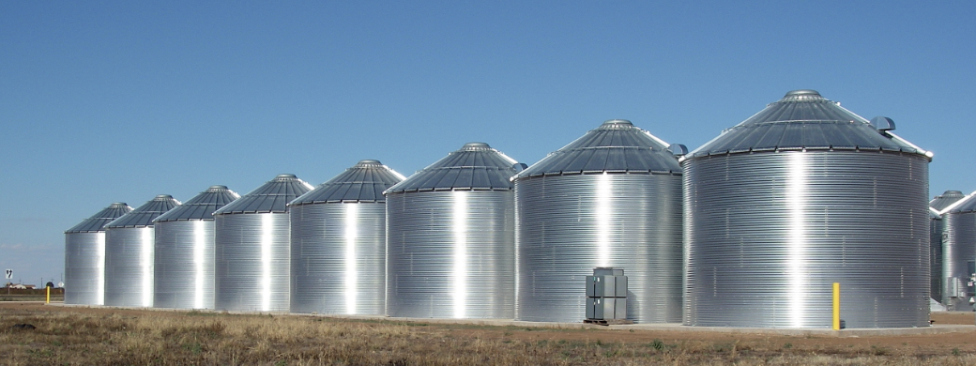
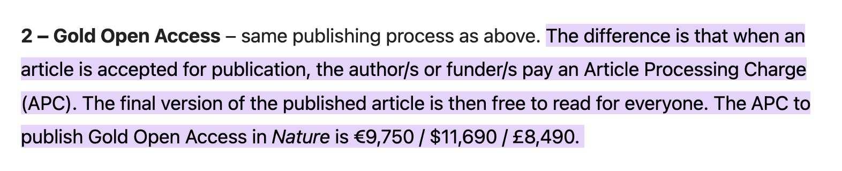
2. Siloing of Knowledge

Slide 22
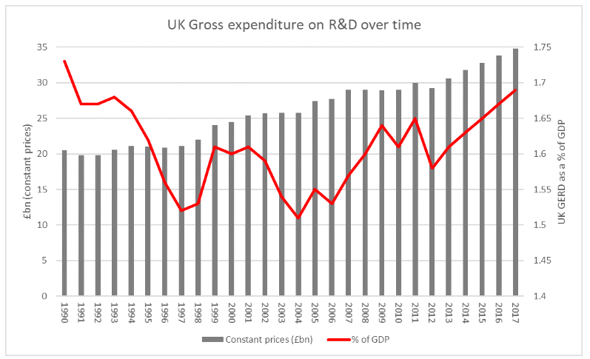
3. Public Benefit: Returns on Public Investment
Increasing scrutiny of public investment in research projects and infrastructures
Changing models of university financing
http://www.sciencecampaign.org.uk/news-media/case-comment/uk-r-d-investment-rises-in-2017.html
Notes:
Improving efficiency in science
by reducing duplication and the
costs of creating, transferring and re-using data; enabling more
research on the same data.

Slide 23

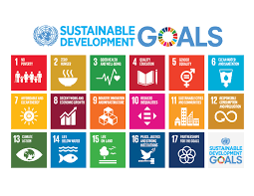
3. 4. SDGs and Global Good
Increased support and funding for research that addresses SDGS and contributes to global development

Slide 24
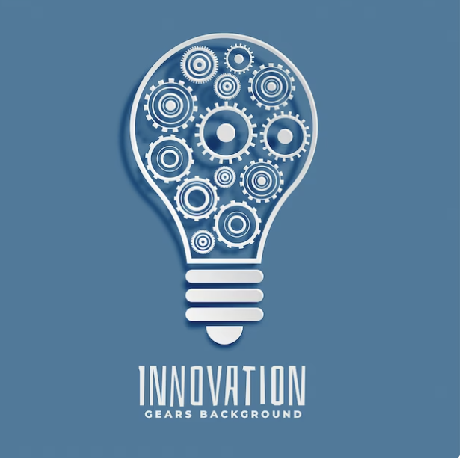
5. Blurred Lines
Academia
Industry
Civil Society
Government

Slide 25
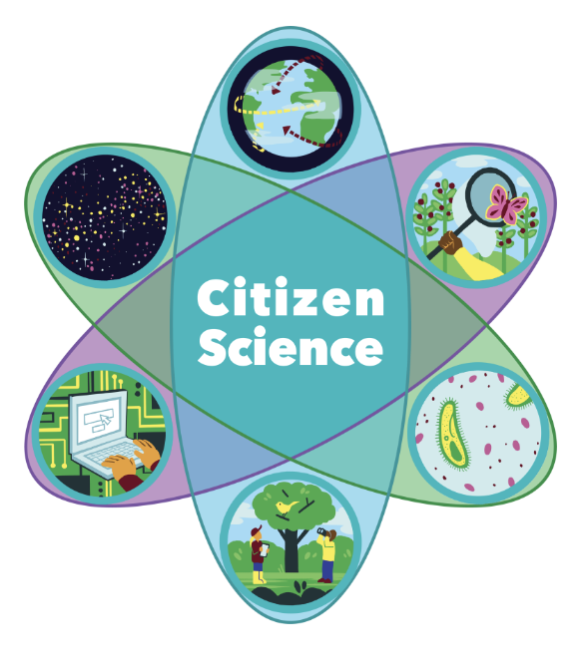
6/7. Societal Involvement
https://citizenscience.org/youth-learning/

Slide 26
New Challenges for Responsible Research Models
Broader scope for research impact, but ….
How do we distribute responsibility in/for digital systems and distributed research
How do we facilitate the inclusion of non-researchers in research
How do we manage sharing and re-use of data
Control
Ownership
Inclusion
Reuse

Slide 27
Particify slide
partici.fi/28561866
Notes:
https://ars.particify.de/edit/28561866/series/Monday

Slide 28
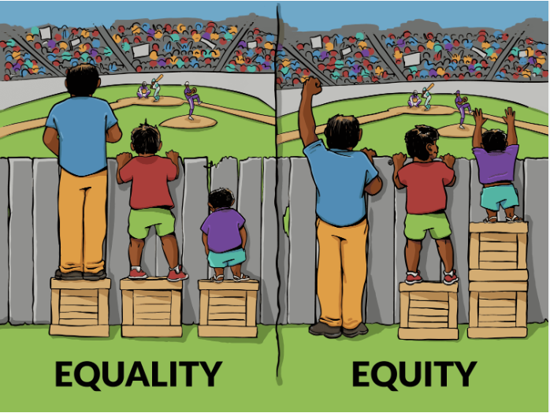
Questions for Responsible Research
How to balance the power of digital technologies vs responsible research?
How to enable changes to culture of science?
How can research benefit the most number of people around the world?
How do we support equitable research?

Slide 29
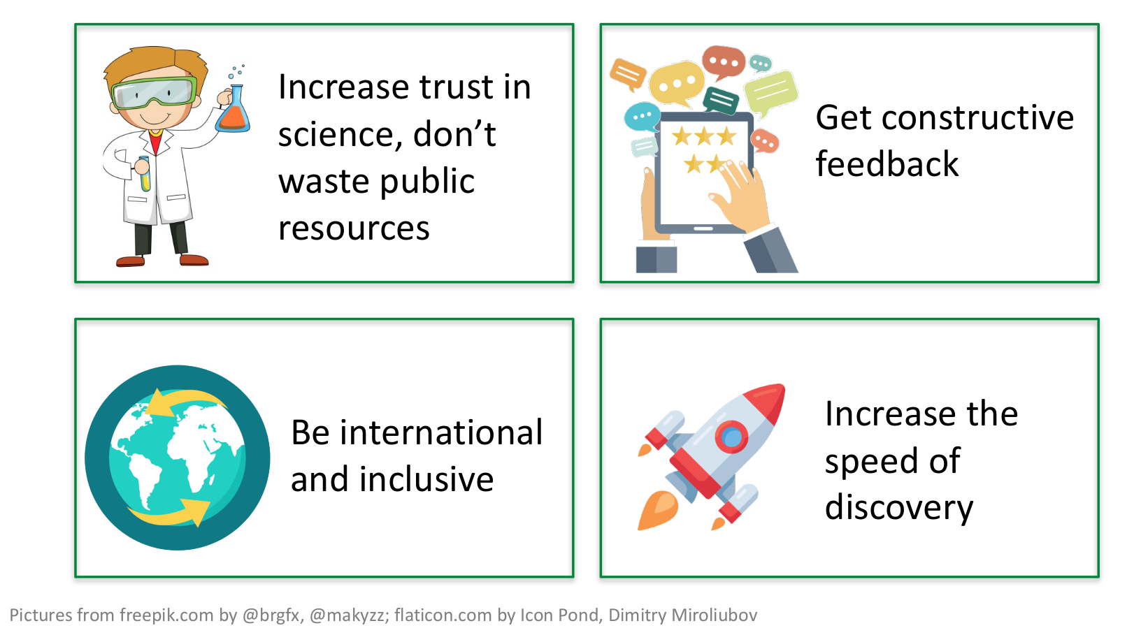
Time For A New Approach?
We need to start to effectively share

Slide 30
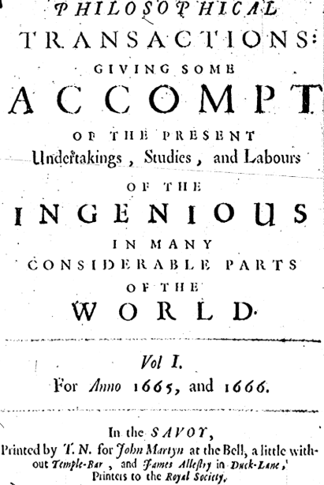
Is Openness the Answer?
Science has always been open(ish)
Long tradition of sharing resources and scrutinizing research
Transparency of data and sharing of resources key to advancing research
Notes:
Not a new concept

Slide 31
Particify slide
partici.fi/28561866
Notes:
https://ars.particify.de/edit/28561866/series/Monday

Slide 32
Any Questions?
partici.fi/28561866

Slide 33
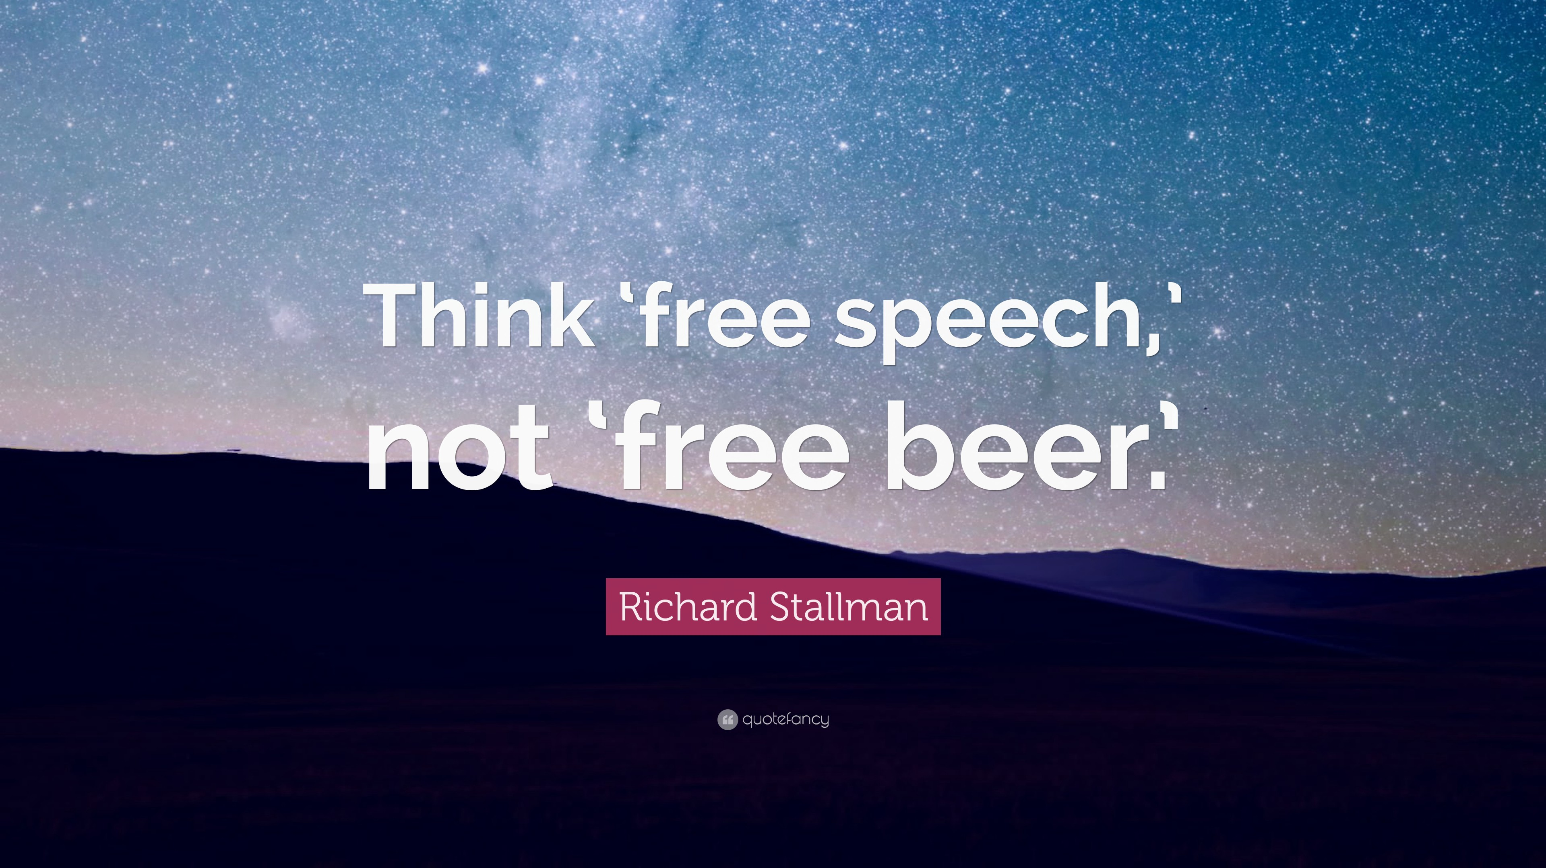
Open Science
The products of scientific research should be freely available to everyone to use and republish as they wish, without restrictions from copyright, patents or other mechanisms of control
Gratis versus Libre
"Free" means there is no cost, where libre means "at liberty", referring to the freedom to modify source code. Libre doesn't mean gratis. Libre can mean available. Libre can mean without restriction

Slide 34
Scope of Open Science
The movement to make scientific research, data and dissemination accessible to all levels of an inquiring society
Scope:
Transparency in experimental methodology, observation, and collection of data
Public availability and reusability of scientific data
Public accessibility and transparency of scientific communication
Using web-based tools to facilitate scientific collaboration

Slide 35
Open Science is Many Things
Open Science includes activities that:
facilitate resource sharing
improve awareness of sharing
create linkages between resources
advocate for removal of financial barriers
advocate for just distribution of resources

Slide 36
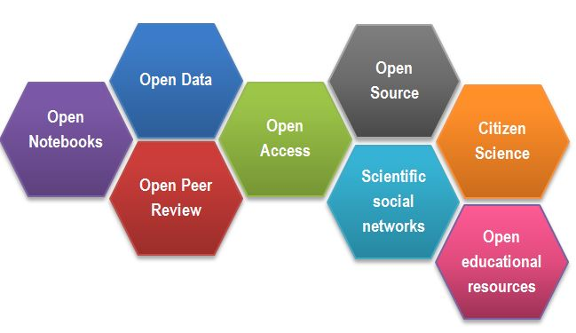
Open Science: an Umbrella for Many Activities
https://www.fosteropenscience.eu/content/what-open-science-introduction
Notes:
Open Notebooks -
an emerging practice,
documenting and sharing the experimental
process of trial and error;
•
Open Data
-
managing research data in a way that
optimises access, discoverability and sharing for
use and re-use;
•
Open Research Software
- documenting research
code and routines, and making them freely
accessible and available for collaboration;
•
Open Access
- making all published outputs freely
accessible for maximum use and impact.

Slide 37
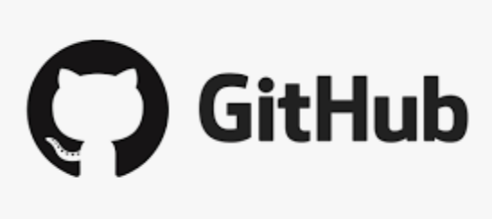



Free and Open Source Software
Software that is freely licensed to use, copy, study, and change in any way, with source code openly shared to enable the design of the software to be improved

Slide 38
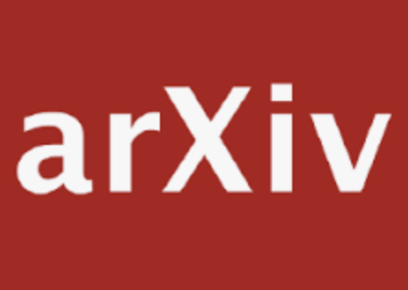



Open Access
Set of principles and a range of practices through which research outputs are distributed online, free of access charges or other barriers

Slide 39

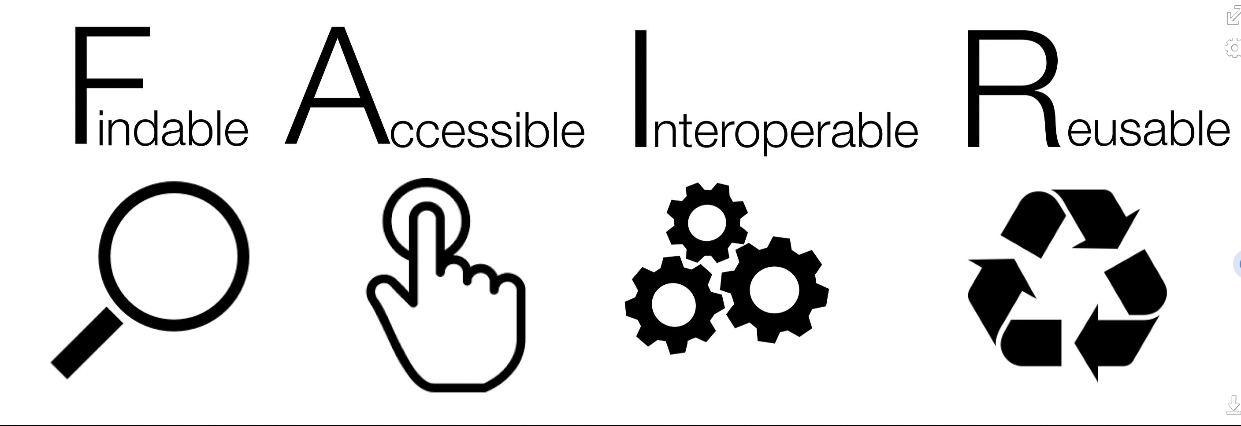
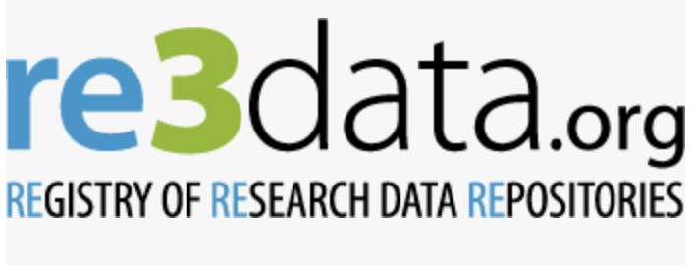
Open Data
Practices to facilitate data being openly accessible, exploitable, editable and shared by anyone for any purpose. Open data is licensed under an open license

Slide 40
Other Open Science Movements 2
Citizen Science
Research conducted, in whole or in part, by amateur (non-professional) researchers.
Also called “public participation”, “participatory monitoring” and “participatory action research”.
Intended to not only advance research, but also to increase public understanding.
Open Peer Review
Any scholarly review mechanism providing disclosure of author and referee identities to one another at any point during the peer review or publication process

Slide 41
Other Open Science Movements (2)
Open Educational Resources
Learning and teaching materials in any format and medium
Available in the public domain or are under copyright that have been released under an open license, that permit no-cost
Allows access, re-use, re-purpose, adaptation and redistribution by others
Scientific social networks
Networks enabling researchers to share their research under open licenses. Ie. ResearchGate
Open Hardware
Physical artifacts of technology designed and offered by the open-design movement.

Slide 42
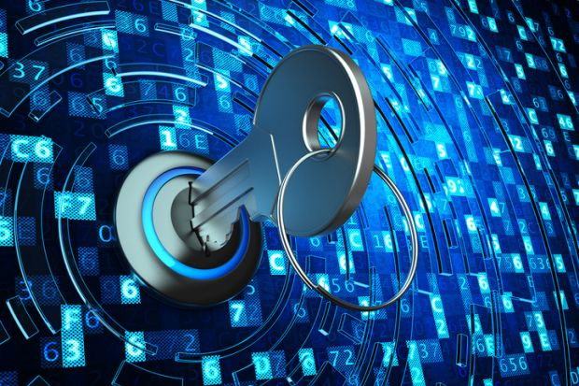
As Open As Possible, As Closed As Necessary
Sensitive data
Commercial applications
National IP and traditional knowledge
Openness is not an Absolute
https://www.timeshighereducation.com/blog/data-should-be-open-possible-and-closed-necessary

Slide 43
Openness Throughout The Research Lifecycle
Open Access
Acquire
Open Data
Present
Clean
Validate
Open Materials
Explore
Model
Preprocess
Open Source
Heidi Seibold
tinyurl.com/opendatascience

Slide 44
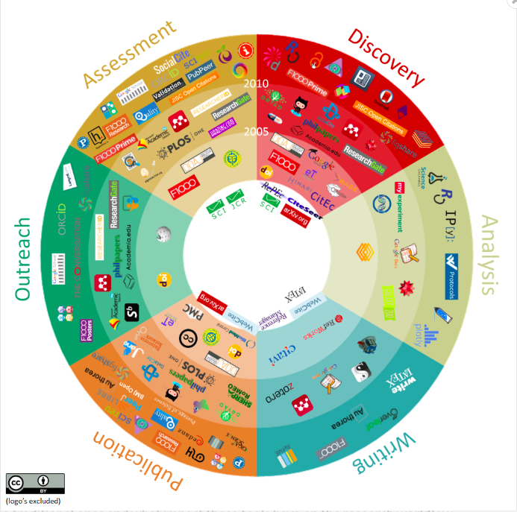
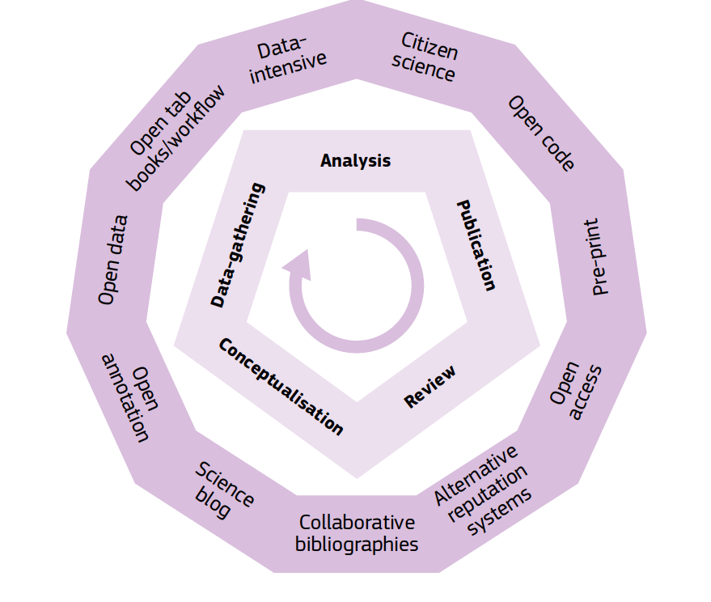
Open Science: Opening Up Research Potential
www.openuphub.eu/component/k2/item/610-101-innovations-in-scholarly-communications

Slide 45
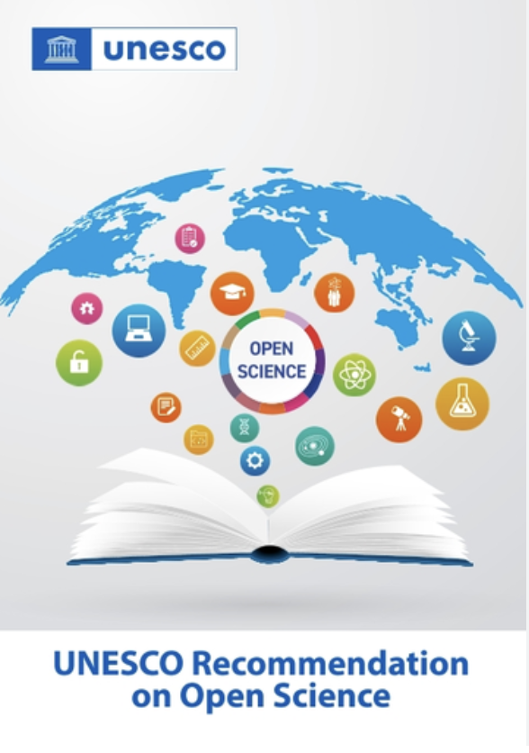
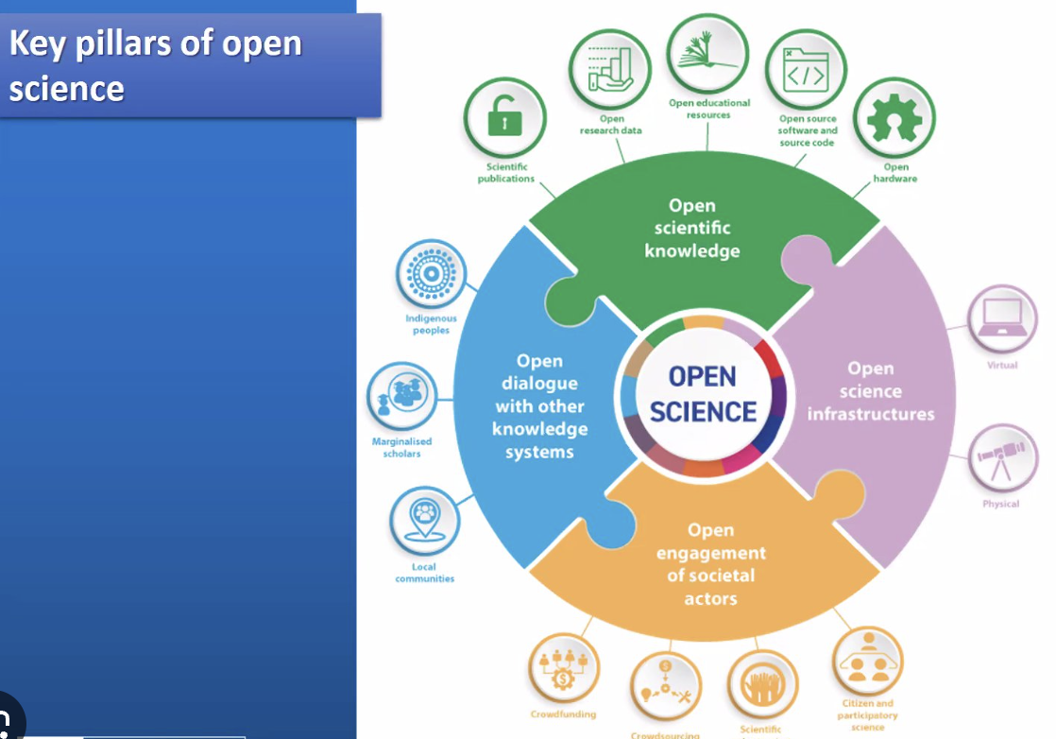
Open Science: Changing Research

Slide 46
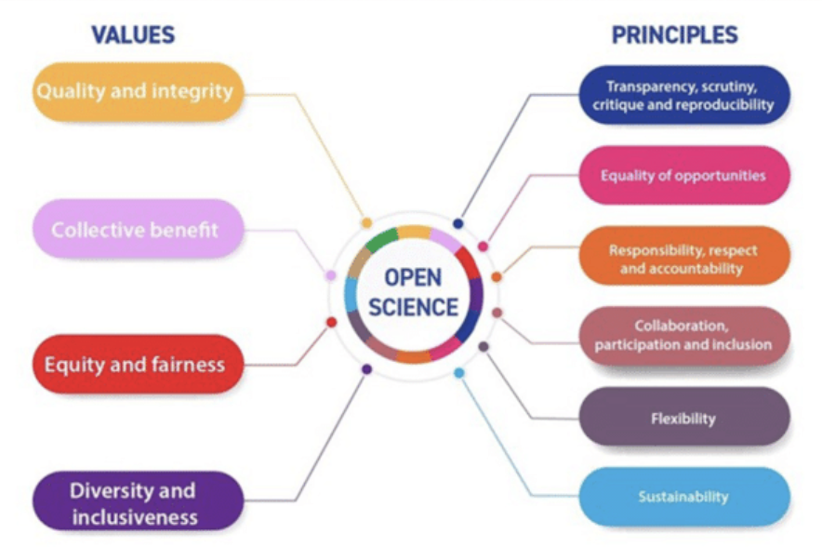
A Way of Thinking And Doing
UNESCO Recommendation on Open Science

Slide 47
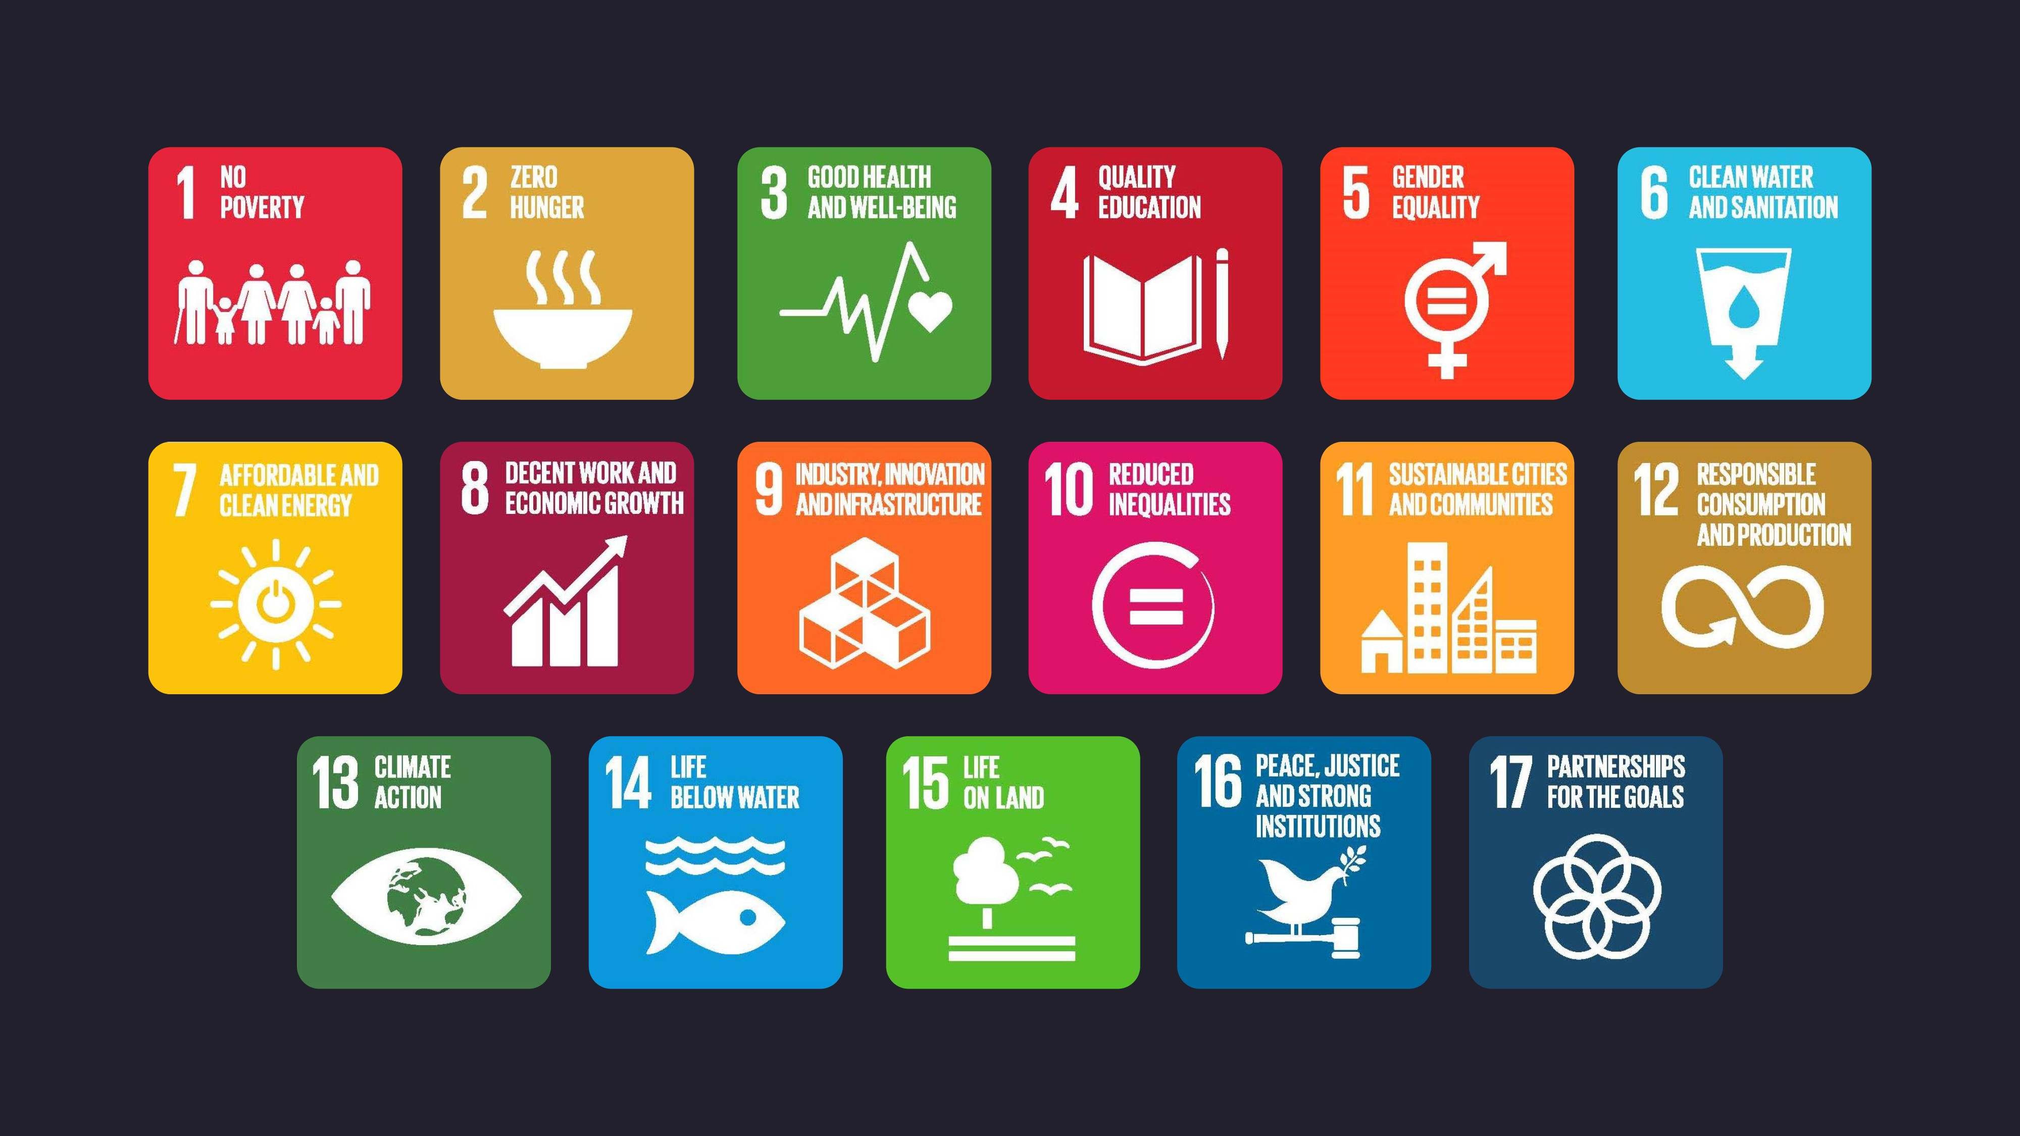
Open Science as a Path to the Future

Slide 48
How Can Open Science Enable Equity?

Slide 49
Open Science: an Extension of RCR Values
Openness can be thought of as an extension of RCR
Open Science and RCR use the same values
Transparency and accountability safeguard against harm and misuse
Openness increases inclusion

Slide 50
Open and Responsible Research
Open Data and Open Methodologies:
Improve transparency and reproducibility of research
Open Lab Books: Transparency in research practices
Sharing and openness: enhance transmission of values
Open Peer Review: Transparency in peer review leads to better dialogue and collegial behaviour
Open Access: Improves availability of research outputs
Open publishing: leads to improved citations, credit and collaboration
Open Science Tools:
Improve collaboration

Slide 51
Openness as a Continuum and a Journey
Open Science is both a cultural movement as well as research decisions/practices
Commitment to openness is the start – like anything, learning to be open takes time, motivation and mentorship/support
Changes to daily research practices can open up all aspects of research
There is no “hard and fast” rule – openness must work for you within your specific work context and with your daily challenges

Slide 52
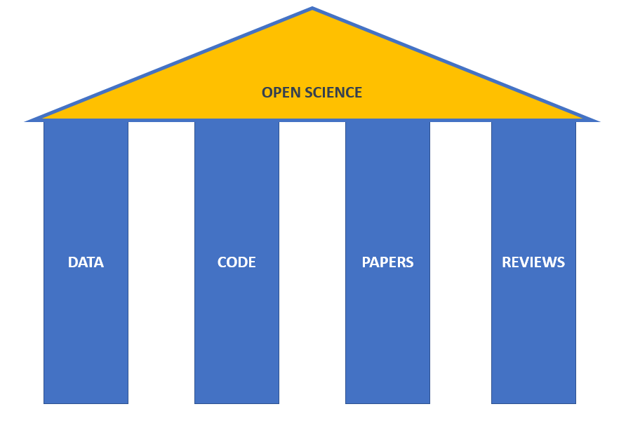
“My” Open Science: What Works for You?
Create
Document
Use
Share
Preserve
Store

Slide 53
Pragmatic Openness
Openness in research is new ... And can be scary
It’s ok to have concerns
It’s ok to realise that not all the open practices will work for you
There can be legal, regulatory, ethical reasons not to share
However, you benefit from the increasingly open research landscape (papers, data, software)
So, how can one avoid ”freeloading”?

Slide 54
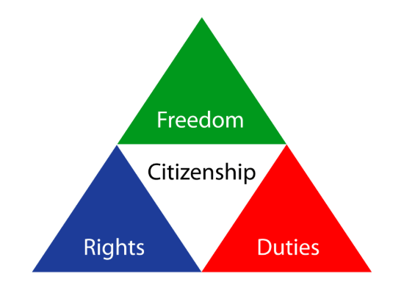
Responsible and Open Research as Citizenship
Citizenship:
ethical obligations arising out of social living
Shared values
being part of a community requires the acceptance of civic responsibilities and contribution to the overall public good
As a citizen you have duties and expected ways of acting
Follow rules
Participate in community activities
Protect the community and its resources from misuse

Slide 55
Responsible and Open Science Citizenship
Research is a community endeavour
Individuals with a shared identity
Shared resources and traditions
Key actions such as resource sharing and communal practice
“Research citizenship” gives us opportunities and responsibilities
Benefits from freedom of research and protection of rights
Benefit from communal resources and practices
Responsibilities to protect and grow culture and community
Notes:
Like being a citizen of a country – you are still a citizen when you are at work, or brushing your teeth, or playing with your children
Your cultural values influence everything that you do and the way that you do it
Similarly for RCR – think of it as a citizenship to the global science community
The values of RCR provide a lens through which you conduct all your different activities – all the different hats that you wear
Give and take

Slide 56
Being a Good Science Citizen
RCR and Open Science form the blueprint for a form of ”science citizenship” that benefits the most equitably
As a “citizen” of the research community you therefore have responsibilities for these resources
Uphold community values (beneficence, equity, transparency)
Follow community determined rules (such as citation, licensing and so forth)
Contribute to communal resources (data sharing)
Maximise good for the community by participating in service (reviewing, curating etc)

Slide 57
Open and Responsible Research Citizenship
Be proud of being part of the community
Remember that everyone has to start somewhere – you learn as you grow
Ethical conduct is part of daily life and small tasks. It’s not just about the big picture
Ethical conduct benefits everyone. It will make you a better researcher and your research better. This is good for everyone!

Slide 58
Particify slide
partici.fi/28561866
Notes:
https://ars.particify.de/edit/28561866/series/Monday

Slide 59
Tools for Responsible, Open (Data) Science
Data science
Practical skills
Norms and values
“Micro ethics”
Data management
Norms and values (FAIR)
Practical tools - RDM
Authorship
ORCID
Journals and licensing
Data use
- Finding and using data
- Data re-use and attribution
Ethics and responsibility
- Areas for activity
Openness, sharing, justice, beneficence

